Slide 1




ENhancing seCurity and privAcy in the Social wEb: a user-centered approach for the protection of minors
AUTH as WP4 Leader: User Profiling for Detection and Prediction of Malicious Online Behavior
V. Moustaka, D. Chatzakou, A.-M. Founta, A. Gogoglou,
E. Papagiannopoulou, T. Terzidou, A. Vakali
Aristotle University of Thessaloniki
Anatolia College, Thessaloniki, May 2019
Funded by the Horizon H2020 Framework Programme of the European Union under grant agreement no 691025.

Slide 2
Users’ behavior and experience when they faced security and privacy risks on OSNs

Slide 3
Problem Formulation
look for : i) user behavior and experience on OSNs,
ii) security threats and privacy risks, and
iii) privacy leakage on OSNs
Identification of the main reasons that motivate users to participate and disclose their personal information in OSNs
Analysis and classification of security and privacy risks on OSNs, focusing on threats concerning children
Analysis of user privacy when sharing information with others and privacy leakage in OSNs
Discussion on encouraging secure online behavior and possible solutions to protect the safety and privacy of users of social networks focusing on children

Slide 4
Conclusions (1/2)
  Privacy concerns the protection of individuals’ personal information from the illegal disclosure and use by third malicious parties and is directly related to the individual's online behavior and privacy preferences
  Security refers to the protection of OSN users from threats caused either by inside attackers (i.e. other OSNs users) or by external attackers (i.e., individuals who do not participate but can commit attacks on the OSNs system) who exploit the unawareness and naivety of their potential victims
  The disclosure of children's information on OSNs is mainly dependent on their parents and the closed family circle (e.g., siblings, relatives, etc.)

Slide 5

Conclusions (2/2)
  The behavior of individuals in OSNs is quite difficult to be adequately clarified and predicted, while is determined mainly by:
    psychological (personal) factors (e.g., level of individual's education, habits, self-esteem, self-presentation, personality, etc.)
    demographic factors (e.g., age, gender, etc.)
    socio-political factors (e.g., legislation related to privacy and security protection, level of public education, city's or country's culture, etc.)

Slide 6
Hate Speech Detection in OSNs

Slide 7

Problem Formulation
Hate Speech Detection in OSNs
Social Media are ubiquitous
Hateful & Abusive behaviors are increasingly emerging online
Everyone is potentially affected (users, OSN companies etc.)
Very hard to address adequately
Controversial topic, thin line between freedom of speech

Slide 8
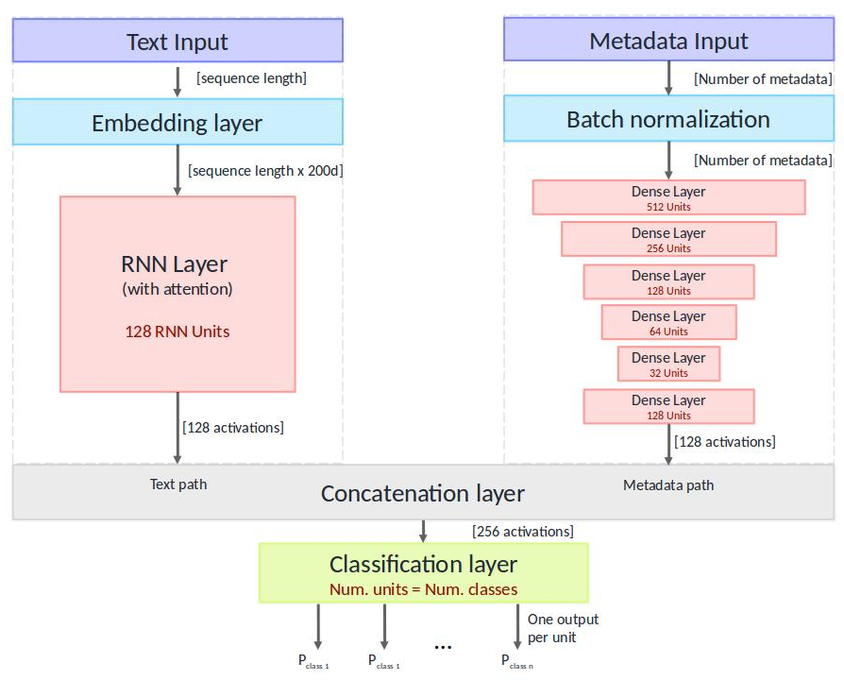
Research Approach (1/2)
Proposal of a unified deep learning architecture for the detection of inappropriate speech on Twitter, using generic features based on previous works
The architecture was tested οn several available annotated datasets and in all cases outperformed the original results
Crowdsourcing annotations to create a large-scale Hate Speech Twitter dataset (100k tweets). The final annotated dataset is publicly available on GitHub and has already been shared with more than 50 researchers worldwide
Publication: Founta, A.M., Chatzakou, D., Kourtellis, N., et al. 2019. A Unified Deep Learning Architecture for Abuse Detection. Accepted in ACM Conference on Web Science (WebSci '19), Boston, USA
Founta, A.M., Djouvas, C., Chatzakou, D., Leontiadis, I., et al. 2018. Large Scale Crowdsourcing and Characterization of Twitter Abusive Behavior. Proceedings of the ICWSM '18, Stanford, California..

Slide 9
Conclusions
  Hateful and abusive speech in OSNs is difficult to differentiate from other forms of profanity
    We propose a methodology for annotating a large-scale dataset of inappropriate speech that distinguishes between the various popularly used types
    We also provide a 100k labeled dataset from Twitter, hoping to assist the research community
  Hate speech can be highly predicted by our proposed unified deep learning classifier that exploits many types of available data and metadata
    The proposed classifier has been tested in multiple Twitter datasets showing high performance and one gaming dataset without any need for fine tuning, in a plug-and-play fashion, showing the potential to easily generalize its use into other platforms

Slide 10
Cyberbullying

Slide 11
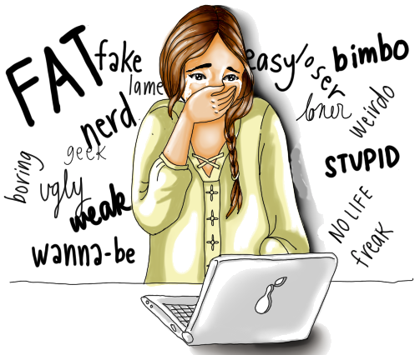
Problem Formulation
Cyberbullying
It is bullying that takes place using electronic technology
For the teenagers it is highly possible to be subject to bully behaviors
70.6% of young people say they have seen bullying in their schools
9% of students in grades 6-12 experienced cyberbullying
15% of high school students (grades 9-12) were electronically bullied in the past year

Slide 12
Cyberaggression vs. Cyberbullying
Cyberaggresion: purposefully saying or doing something to hurt someone (once)
  Delivered by electronic means to a person or a group who perceive such act as offensive, derogatory, harmful or unwanted
Cyberbullying: intentionally aggressive behavior towards a person or a group
  Repeated over time
  Involves an imbalance of power

Slide 13
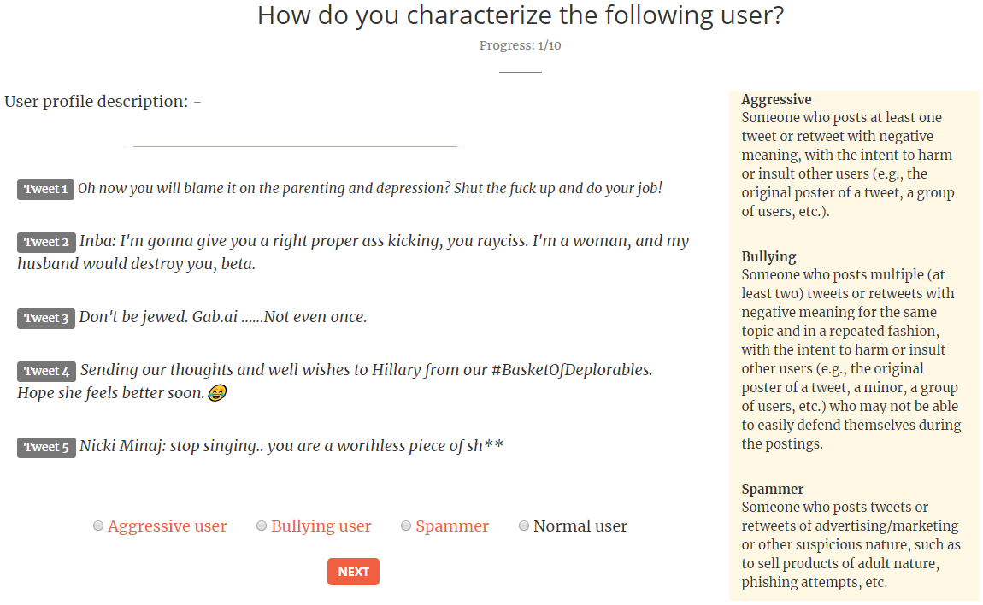
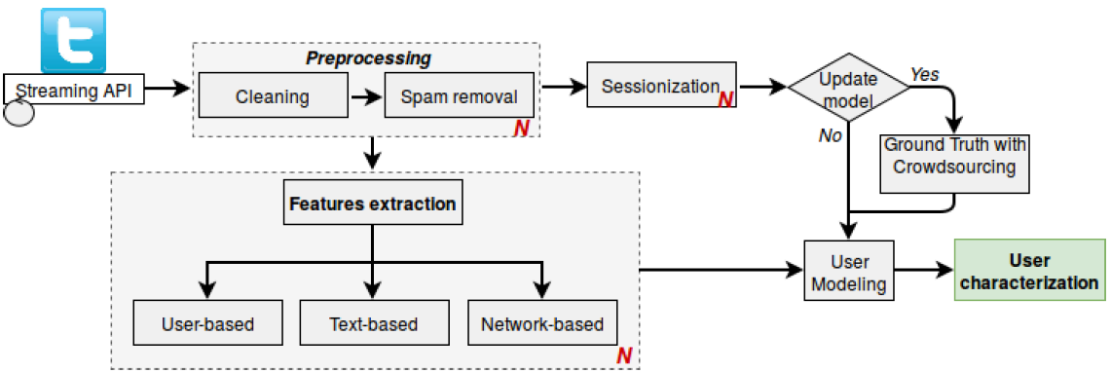

Research Approach
Methodology
Crowdsourcing Tool
Publication: Chatzakou, D., Kourtellis, N., Blackburn, J., De Cristofaro, E., Stringhini, G., & Vakali, A. 2017. Mean birds Detecting aggression and bullying on twitter. In Proceedings of the 2017 ACM on web science conference (pp. 13-22). ACM.

Slide 14
Identifying malicious activity in the vast and varied ecosystem of OSNs

Slide 15

Problem Formulation
Are malicious users placed in isolated distinguishable groups in the large pool of honest OSN users?
How do they manage to connect and penetrate the core of the network and disseminate malicious content?
How can the topology of the network help differentiate malicious from honest users?

Slide 16
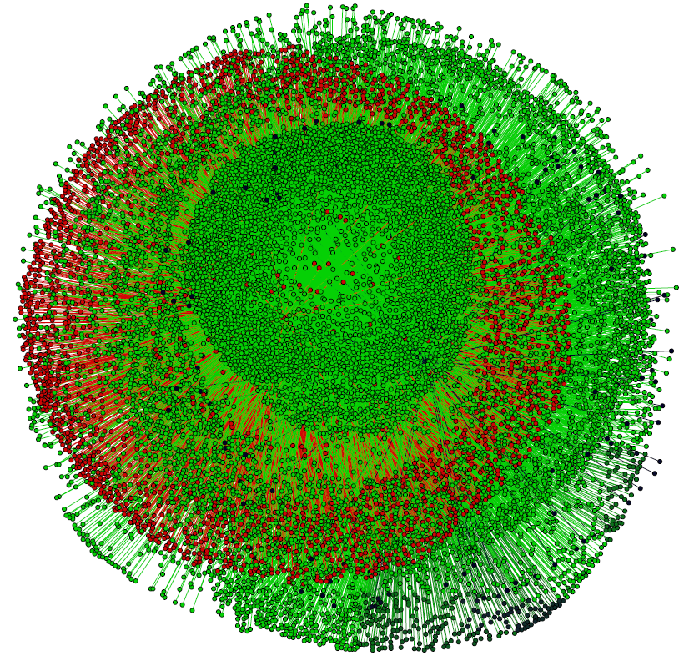
Experimentation
Graph Components
40,000 suspended accounts from Twitter were used as seeds to collect their neighboring subgraphs from a complete graph of 50 million users
Green component: strongly connected core, red: peripheral nodes, black: disconnected nodes (malicious)
The largest connected group of the red component constitutes the “social bridges” - linking malicious to honest users
Behavioral patterns of malicious users and their bridges are distinguishable and can help in preventing under-age users from entering those areas of the network

Slide 17
An overall analysis for all cases and sessions of the Perverted Justice dataset

Slide 18
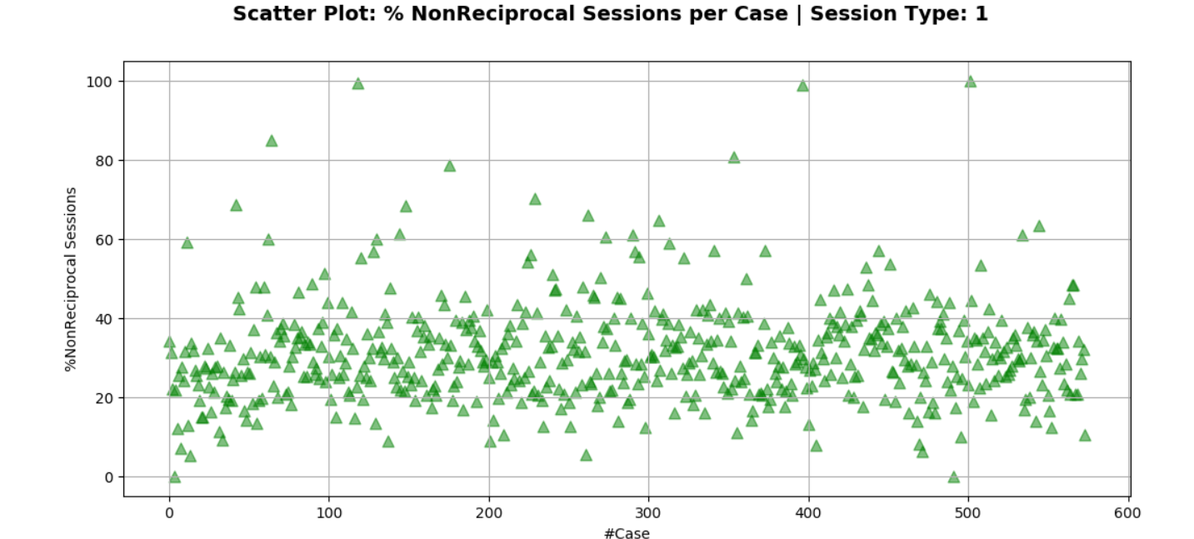
Experimentation (1/5)
Predators tend to insist long enough before aborting a conversation
A reciprocal session was defined as one where both participating parties have posted messages
A non-reciprocal session was defined as one where only one of the parties has send one or more messages
Gives an indication of how the number of cases varies over time
Percentage of all non-reciprocal sessions for all cases

Slide 19
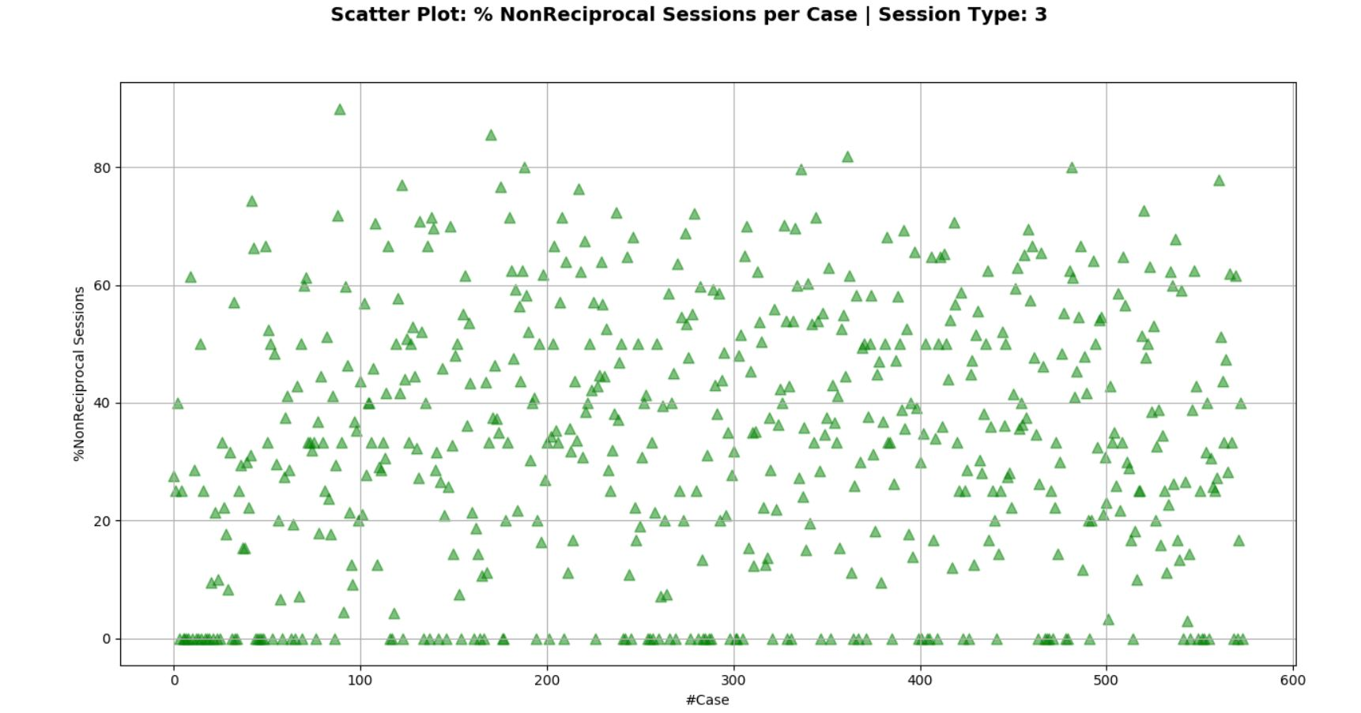
Experimentation (2/5)
Predators tend to insist long enough before aborting a conversation
Analysis of all non-reciprocal sessions for all cases for a larger time window, shows that the percentage of non-reciprocal sessions widens dispersed ranging from 10%-80%
Percentage of all non-reciprocal sessions for all cases for larger time window

Slide 20
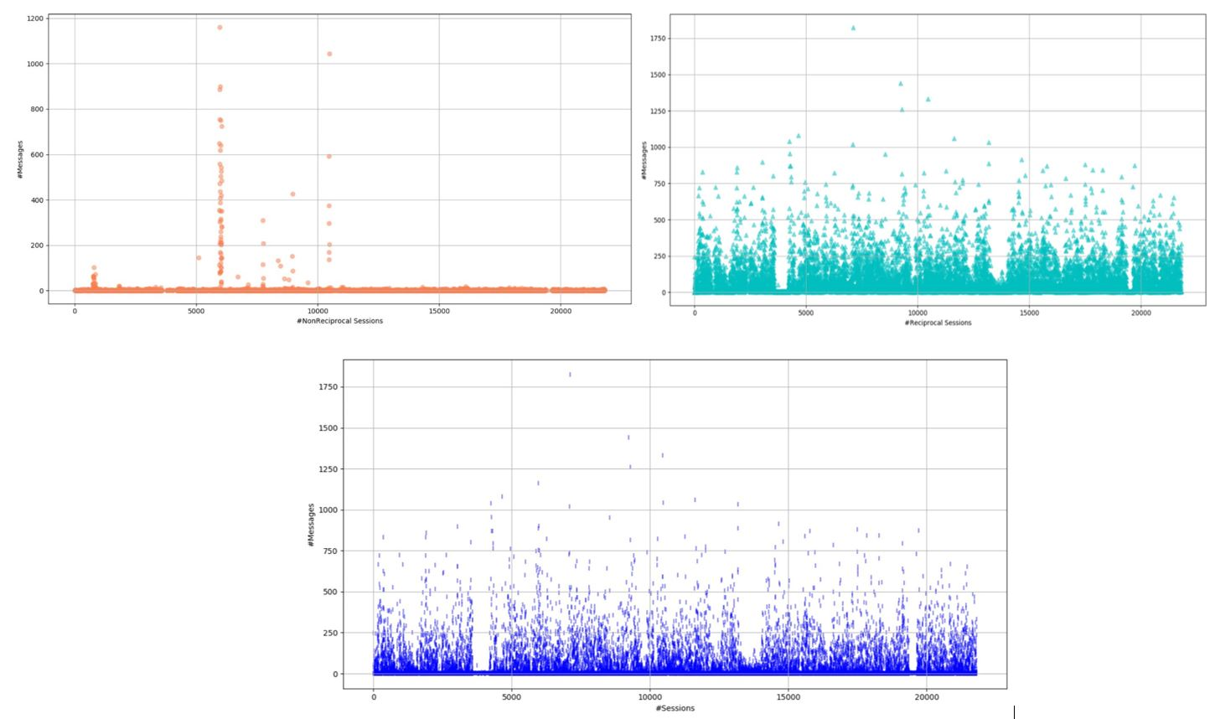
Conclusion #4
Reciprocal sessions: Larger number of exchanging messages for larger time window
[Task 4.3]
Reciprocal sessions: Larger number of exchanging messages for larger time window
Reciprocal sessions: characterized by a larger number of exchanging messages between the victim and the predator
Non-Reciprocal sessions: the increment of the time window between chats confirms the low number of exchanging messages between the victim and the predator (< 100 messages per session for almost all the sessions)
predators tend to insist long enough before aborting a conversation with their potential victim, even when he or she does not respond to their messages
Messages of Non-Reciprocal, Reciprocal and all Sessions for larger time window [Session type: 3]

Slide 21


Research Approach
Literature Review
Selection and critical analysis of more than 70 research articles published the last years in scientific journals and proceedings of international conferences
Publication: V., Moustaka, Z., Theodosiou, A., Vakali, A., Kounoudes, L.-G., Anthopoulos. (2019). Enhancing Social Networking in Smart Cities: Privacy and Security Borderlines. Technological Forecasting & Social Change 142, 285-300.

Slide 22

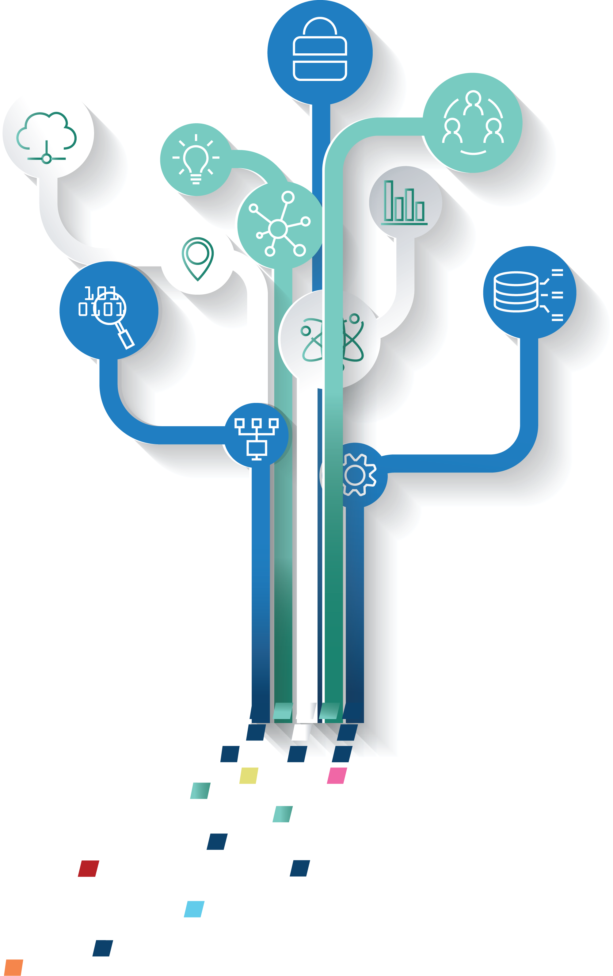

Slide 23


Thank you!
avakali@csd.auth.gr

